Slide 1
Rendering district annotation on web maps using vector tiles – an use case for address rendering for the purposes other than mail -
Hidenori FUJIMURA
Expert for 19160-5
(Director, Information Access Division, Geospatial Information Department, Geospatial Information Authority of Japan)

Slide 2
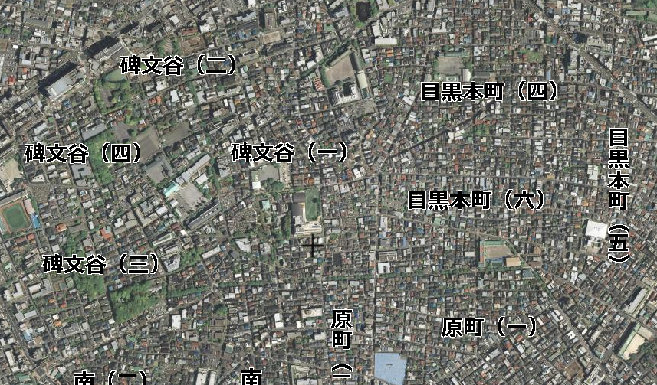
Overview
Since June 2015, GSI started providing experimental vector tile dataset of annotation data covering whole area of Japan. They are served as GeoJSON vector tiles.
The dataset is integrated in GSI Maps (http://maps.gsi.go.jp/ ). In GSI Maps, the annotation data, which includes the name of the district which is a part of address, are rendered reflecting writing direction (vertical or horizontal) and orientation.
You can see the example as shown in the screenshot below via http://maps.gsi.go.jp/?ll=35.618651,139.691044&z=16&base=ort&ls=relief%7Cexperimental_anno&vs=c1j0l0u0 if you have Internet connection (and Japanese fonts ☺).
Name of the district
In vertical writing

Slide 3
Current implementation
Data are encoded as GeoJSON vector tiles. Example: http://cyberjapandata.gsi.go.jp/xyz/experimental_anno/15/29106/12903.geojson
The rendering rule is encoded as JavaScript code as in http://cyberjapandata.gsi.go.jp/xyz/experimental_anno/style.js
The specification of the rendering rule is dependent on the API of Leaflet (http://leafletjs.com/), and documented by GSI as style-dot-js-spec (https://github.com/gsi-cyberjapan/style-dot-js-spec , in Japanese).
Annotations are rendered thanks to the functions of CSS (Cascading Style Sheets) implementation of modern web browsers.
E.g. change of writing direction is realized by the use of ‘writing-mode’ (or –ms-writing-mode, -webkit-writing-mode, -moz-writing-mode, -o-writing-mode) of CSS.
[FYI] README for GSI Vector Tile Experiment (https://github.com/gsi-cyberjapan/vector-tile-experiment/blob/gh-pages/README_en.md , in English)
<Question from Hide>
Can this really be the use case for 19160-5? I see my use case is very specific to implementation detail. Does 19160-5 standardize the more abstract things so that we can decide whether my use case is ‘conformant’ with 19160-5? Or does 19160-5 define some “language” for rendering rule so that some new (probably more implementation dependent) layer inserted in my use case? Or other?
By considering the question above, we may be able to answer how my use case be the use case for 19160-5, and further, we may be able to define a good format for the use cases for 19160-5. In other words, more detailed scope of the new standard may be useful for use case writers.

